Slide 1
STEPS INVOLVED IN A RESEARCH PROCESS

Slide 2
What are the Stages in the Research Process?
The steps of the process are as follows
1. Defining the research objectives (What is to be done?)
2. Planning a research design ( How it to be done?)
3. Planning a sample ( From where will the data be taken or observed ?)
4. Collecting the data ( How the data will be collected?)
5. Analyzing the data ( Which analytical method will be chosen?)
6. Formulating the conclusions and preparing the report
The above sequence of activities are highly interrelated . The stages of the research process overlap continuously, and not necessarily follows exactly the same ordered sequence of activities

Slide 3
Defining the Research Objectives
The goals to be achieved by conducting research are called as Research objectives.
The genesis of the research objectives lies in the type of decision situation faced.
In applied business research, the objectives cannot really be determined until there is a clear understanding of the managerial decision to be made. The managerial decision situation arises because of a problem or opportunity.
For example. Low sales volume may be due to many reasons. Low advertising expenditure may be one of these. Others being less number of stores, price, quality etc. Whether the advertising expenditure should be increased (and by what amount) or more stores are to opened is the decision to be taken.
For advertising a research of the Industry expenditure and competitor expenditure is to be done all other things remaining constant..

Slide 4
Planning the Research Design
A research design is a master plan that specifies the methods and procedures for collecting and analyzing the needed information.
Objectives of the study determined during the early stages of research are included in the design to ensure that the information collected is appropriate for solving the problem.
The researcher also must determine the sources of information, the design technique (survey or experiment, for example), the sampling methodology, and the schedule and cost of the research.

Slide 5
Sampling
Sampling involves any procedure that draws conclusions based on measurements of a portion of the population.
One of the sampling issue concerns sample size. How big should the sample be? Although management may wish to examine every potential buyer of a product or service, doing so may be unnecessary as well as unrealistic. Other things equal, larger samples are more precise than smaller ones. However, proper probability sampling can allow a small proportion of the total population to give a reliable measure of the whole.
The first sampling question to ask is “Who is to be sampled?” The answer to this primary question requires the identification of a target population. Who do we want the sample to reflect?

Slide 6
Gathering Data
Data may be gathered by human observers or interviewers, or they may be recorded by machines.
Research techniques involve many methods of gathering data. Surveys require direct participation by research respondents. This may involve filling out a questionnaire or interacting with an interviewer. In this sense, they are obtrusive.
Unobtrusive methods of data gathering are those in which the subjects do not have to be disturbed for data to be collected. They may even be unaware that research is going on at all. For instance, a simple count of motorists driving past a proposed franchising location is one kind of data gathering method.

Slide 7
Processing and Analyzing Data
Editing and coding
Data processing generally begins with editing and coding the data. Editing involves checking the data collection forms for omissions, legibility, and consistency. The editing process corrects problems such as interviewer errors before the data are transferred to the computer. Before data can be tabulated, meaningful categories must be established for groups of responses. The rules for interpreting, categorizing, recording, and transferring the data to the data storage media are called codes. This coding process facilitates computer or hand tabulation.
Data analysis
Data analysis is the application of reasoning to understand the data that have been gathered. The appropriate analytical technique for data analysis will be determined by management’s information requirements, the nature of the data gathered. Statistical analysis may range from portraying a simple frequency distribution to more complex multivariate analyses approaches, such as multiple regression.

Slide 8
Drawing Conclusions and Preparing a Report
The conclusions and report preparation stage consists of interpreting the research results, describing the implications, and drawing the appropriate conclusions for managerial decisions.
These conclusions should fulfill the deliverables promised in the research proposal. In addition, it’s important that the researcher consider the varying abilities of people to understand the research results.

Slide 9
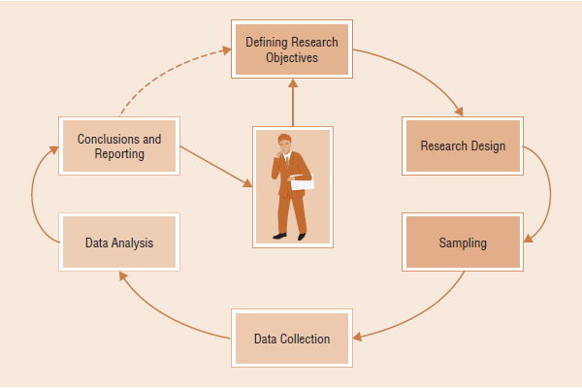
SIX STAGES AS A CYCLICAL OR CIRCULAR-FLOW PROCESS

Slide 10
The terms forward linkage and backward linkage reflect the interrelationships between stages.
Forward linkage implies that the earlier stages influence the later stages. Thus, the research objectives outlined in the first stage affect the sample selection and the way data are collected. The sample selection question affects the wording of questionnaire items. For example, if the research concentrates on respondents with low educational levels, the questionnaire wording will be simpler than if the respondents were college graduates.
Backward linkage implies that later steps influence earlier stages of the research process. If it is known that the data will be collected via e-mail, then the sampling must include those with e-mail access. A very important example of backward linkage is the knowledge that the executives who will read the research report are looking for specific information. The professional researcher anticipates executives’ needs for information throughout the planning process, particularly during the analysis and reporting.

Slide 11
THANK YOU

